Slide 1
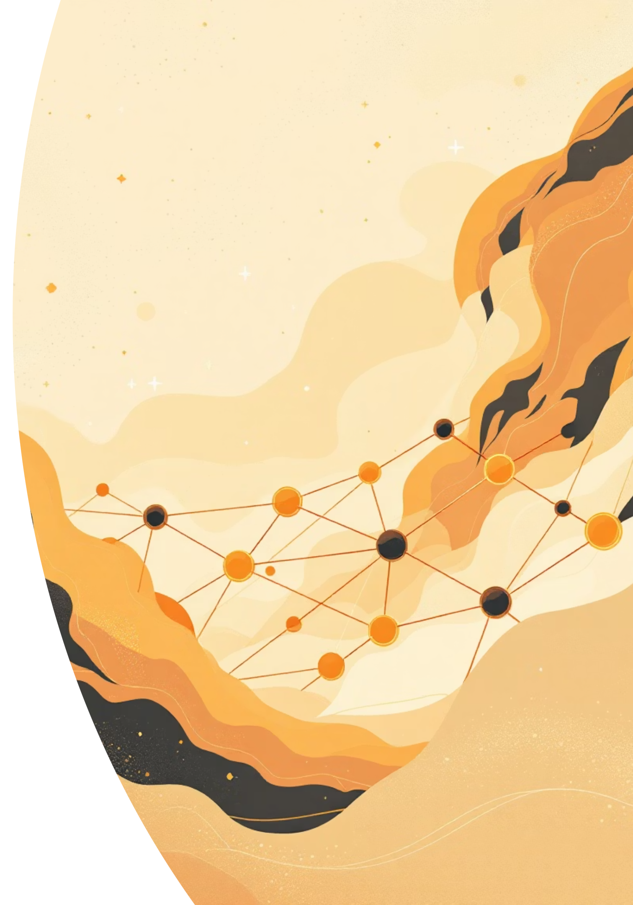
Blockchain for Insurance
The Future of Trust and Transparency

Slide 2


What Is Blockchain?
Think of blockchain as a digital notebook that everyone can read, but no one can erase or change secretly. It's a technology that stores information in connected blocks, creating a permanent record that's shared across many computers.
Decentralized
Transparent
No single person or company controls it. The information lives on thousands of computers simultaneously, making it nearly impossible to hack or manipulate.
Everyone can see the transactions. All participants have access to the same information, creating trust through visibility rather than relying on a middleman.
Secure
Once information is recorded, it can't be changed. Each block links to the previous one using complex math, creating an unbreakable chain of verified data.

Slide 3
The Insurance Industry's Big Problems
Today's insurance system faces serious challenges that frustrate both customers and companies. These issues cost billions of dollars annually and erode trust in the industry.
Widespread Fraud
Slow Processing
Zero Transparency
Insurance fraud costs the industry over $40 billion per year in the U.S. alone. Fake claims, inflated damages, and staged accidents drain resources that could go toward legitimate claims. Traditional systems struggle to detect sophisticated fraud patterns.
Filing a claim can take weeks or even months. Customers wait anxiously while paperwork moves between departments, adjusters investigate, and approvals crawl through bureaucratic channels. Emergency situations become financial crises during these delays.
Where is my claim? Why was I denied? Customers rarely understand how decisions are made. The black box of insurance processing creates frustration, disputes, and a fundamental lack of trust between insurers and policyholders.

Slide 4




How Blockchain Transforms Insurance
Blockchain technology transforms the insurance industry by introducing transparency, automation, and trust.Instead of depending on paperwork, intermediaries, and manual verification, every transaction is securely recorded on a shared digital ledger that all parties can view in real time.This allows instant verification of data, automatic claim processing through smart contracts, and reduced chances of fraud or manipulation — making insurance processes faster, fairer, and more reliable.
Blockchain creates a permanent, tamper-proof record of every policy, claim, and transaction in the insurance system.Because this ledger is immutable and visible to all authorized parties, it becomes nearly impossible to alter or falsify information, drastically reducing fraud.At the same time, the transparency and automation built into the system allow legitimate claims to be verified and processed in minutes instead of weeks, improving efficiency and customer satisfaction.
Prevents Fraud
Speeds Up Claims
Creates Transparency
All transactions are recorded permanently and verified by multiple parties, making it impossible to submit duplicate claims or fake documents.
Smart contracts automatically verify and process claims based on predefined rules, eliminating manual review for straightforward cases.
Everyone can see the status and history of policies and claims, building trust through visibility and accountability.

Slide 5




Key Applications in Insurance
Automated Claims Processing
Fraud Detection
Smart contracts trigger automatic payouts when conditions are met. For example, flight delay insurance can automatically pay you the moment your flight is officially delayed, verified through airline data feeds. No forms, no waiting, no hassle.
Blockchain creates a shared database of all claims across insurers. If someone tries to claim the same accident twice with different companies, the system immediately flags it. Pattern recognition algorithms spot suspicious behavior across the entire network.
Smart Contracts
Identity Verification
These are self-executing agreements written in code. When predetermined conditions are met, the contract automatically executes without human intervention. Think "if this happens, then pay that amount" encoded into an unstoppable program.
Your identity and insurance history are stored securely on the blockchain. When applying for new coverage, insurers can instantly verify your information without requesting mountains of documentation. Your data stays with you and under your control.

Slide 6



Real-World Success Stories
Major companies are already using blockchain to revolutionize insurance, moving from theory to practical applications that save money and improve customer experiences.
Etherisc
B3i Consortium
IBM Insurance Platform
This platform offers automated flight delay insurance. Purchase coverage in seconds, and if your flight is delayed beyond the threshold, payment hits your wallet automatically. Over 15,000 policies have been processed with zero paperwork.
A consortium of 40+ major insurers including Allianz, Swiss Re, and Munich Re. They've developed blockchain solutions for complex commercial insurance, reducing processing time by 80% and cutting administrative costs dramatically.
IBM's blockchain platform helps insurers manage policies and claims with unprecedented efficiency. Their system processes subrogation claims between insurance companies in days instead of months, with complete transparency for all parties.

Slide 7

Benefits for Everyone Involved
For Customers 🙂
For Insurance Companies 📊
Lightning-fast payouts
Massive cost savings
Get your money in minutes instead of weeks when you need it most
Automation reduces operational expenses by up to 70%
Lower premiums
Fraud elimination
Reduced fraud and administrative costs mean savings passed to you
Save billions annually by preventing fraudulent claims before payout
Complete transparency
Better customer trust
See exactly what you're paying for and track your claim every step
Transparency and speed create loyalty and positive reputation
Control your data
Competitive advantage
Your information stays with you, shared only when you choose
Early adopters gain market share with superior service

Slide 8
The Challenges Ahead
Despite its promise, blockchain faces significant hurdles before becoming the insurance industry standard. Understanding these limitations is crucial for realistic expectations about adoption timelines.
1
2
Scalability Issues
High Implementation Costs
Current blockchain networks process only 7-15 transactions per second, while traditional systems handle thousands. Major insurance companies process millions of transactions daily. Solutions like layer-2 networks are in development but not yet proven at scale.
Switching from legacy systems to blockchain requires massive upfront investment. Companies must rebuild entire IT infrastructures, retrain staff, and maintain both systems during transition. Small and mid-size insurers may struggle to afford the transformation.
3
4
Regulatory Uncertainty
Industry Resistance
Insurance is heavily regulated, but most regulations were written before blockchain existed. Governments worldwide are still figuring out how to classify and regulate blockchain insurance products. Legal frameworks lag behind the technology.
Large, established companies are slow to change. Many executives remain skeptical, and existing systems, though inefficient, are familiar and proven. Overcoming organizational inertia requires demonstrating undeniable value.

Slide 9
The Future of Blockchain Insurance
The insurance industry stands at a turning point. While challenges exist, the momentum toward blockchain adoption is undeniable. Industry analysts predict that by 2030, blockchain could power 30-40% of all insurance transactions globally.
2024-2025
2028-2030
Major insurers expand pilot programs for simple products like travel and parametric insurance
Blockchain becomes standard for new policies as technology matures and costs decrease
1
2
3
4
2026-2027
2030+
Regulatory frameworks emerge in major markets, enabling broader commercial deployment
Traditional insurance systems phase out, replaced by fully automated, transparent blockchain platforms
"Blockchain will do for insurance what the internet did for information—make it instantly accessible, radically transparent, and fundamentally more efficient."
The question isn't whether blockchain will transform insurance, but how quickly companies can adapt to this inevitable change.

Slide 10
Insurance Made Smarter, Faster, and More Secure
Blockchain technology promises to solve insurance's biggest problems—fraud, delays, and lack of trust. While challenges remain, the benefits are too significant to ignore. For you as future customers and potential industry professionals, understanding this transformation gives you an advantage in a rapidly changing landscape.
💡 The Big Idea
⚡ The Impact
🚀 The Future
Blockchain replaces trust in institutions with trust in transparent, automated systems that work for everyone
Faster claims, lower costs, and better protection for customers and insurers alike
Within a decade, blockchain insurance could be as common as online banking is today
The future of insurance isn't just digital—it's decentralized, transparent, and built on blockchain. And that future is closer than you think.

